Slide 1

Project Title - Seasonal Agriculture Performance Analysis
[ Student Name : Dadi Hemanth Kumar
College Name - Raghu Engineering College ]
AICTE STU ID : (STU67ea4fd1781621743409105)

Slide 2

PROBLEM STATEMENT
(Agricultural activities are influenced by seasonal variations in environmental conditions, farming practices, resource availability and market conditions. As a result, agricultural performance may differ from one season to another. However, raw agricultural data does not clearly explain how agricultural performance changes across seasons or what patterns can be observed in different seasonal conditions. The problem is to analyze the given agricultural dataset and investigate seasonal differences in agricultural performance by identifying meaningful patterns, trends, relationships and variations within the available data.

Slide 3
Project Description :
This project analyzes agricultural performance on Kharif, Rabi and Zadi seasons.The dataset was cleaned and anlyzed by removing null values and duplicate rows to understand yield,production,profit crop and irrigation analysis. On also on Seasonal environmental conditions , irrigation methods were compared . This helps in seasonal comparisions and visualizations to identify important patterns and varitions.
Correlation analysis was performed to understand relationships between different agricultural factors and yield. One-way ANOVA was used to check whether the differences in average yield across seasons were statistically significant. Based on the findings, suitable conclusions and data-driven recommendations were developed.

Slide 4

WHO ARE THE END USERS?
Farmers
Agricultural departments
Water management terms
Agricultural Researchers
Crop management Professionals

Slide 5

Technology Used
Python
Pandas
NumPy
Matplotlib
Seaborn

Slide 6
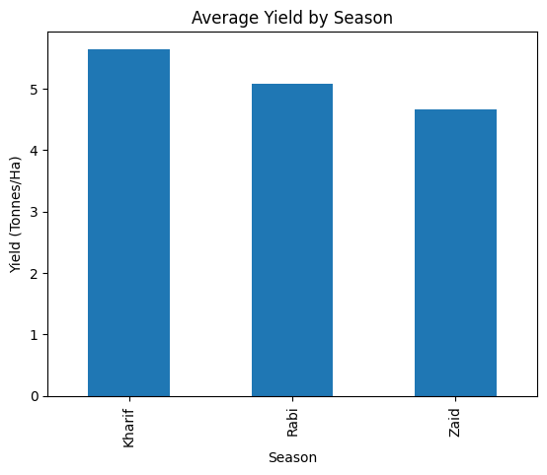
RESULTS
Kharif recorded the highest average yield
Followed by Rabi and Zaid.

Slide 7
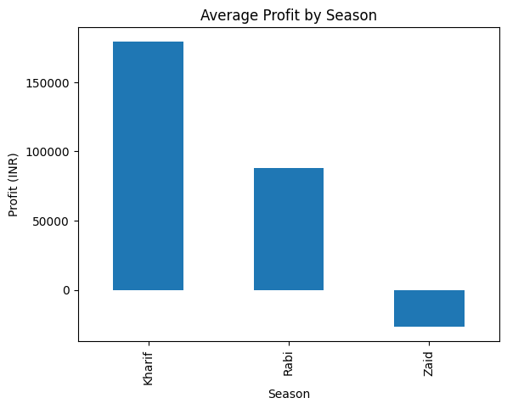
RESULTS
Kharif has highest average profit, while Zaid has negative average profit.
This tells variation in ecnomic performance of farming across seasons.

Slide 8
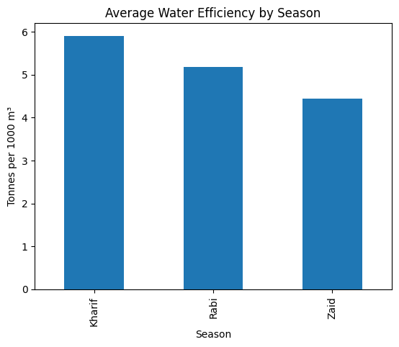
RESULTS
Zaid has lowest water efficiency, while Kharif has highest water efficiency.
This tells how efficiently water is utilized.

Slide 9
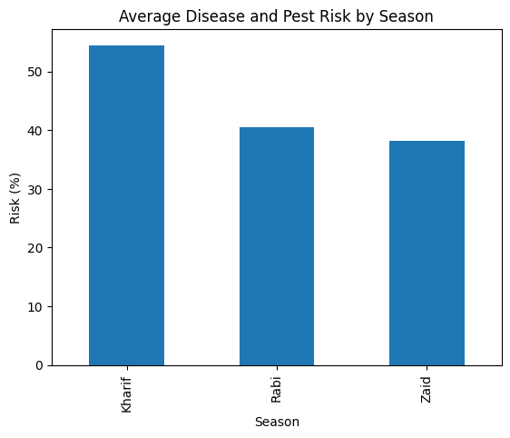
RESULTS
From bar graph, Kharif showed the highest average in disease and pet risk in all three seasons.
This tells agricultural risk varies in seasonal conditions.
Here, highest season has highest disease and pet risk .

Slide 10
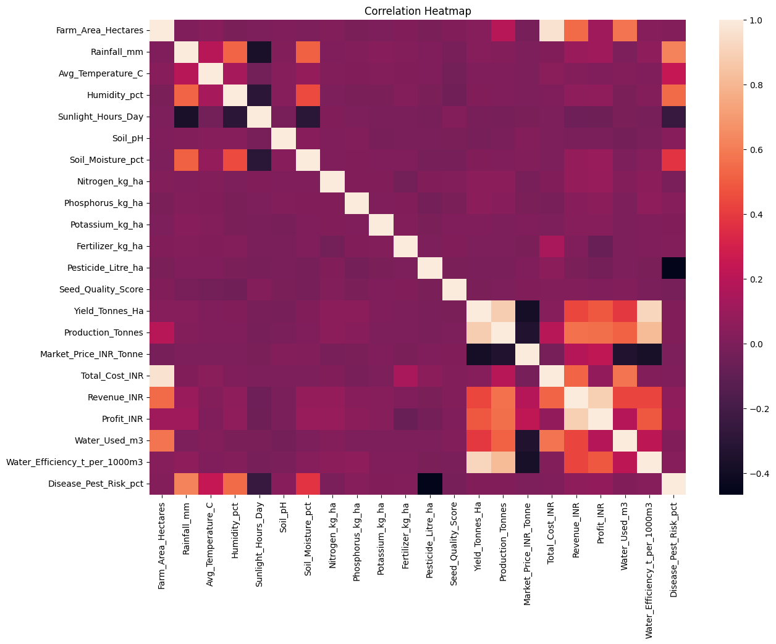
RESULTS
Correlation tells how strong variables related to each other.
Its range is from ( -1 to 1)
Here water efficiency with yield has positive relationship

Slide 11
Future scope
Future analysis can focus on predicting crop yield and profit using historical data.
A simple dashboard can be developed to make the results easier to understand.
The analysis can be extended using data from more years and regions.

Slide 12
GitHub Link
https://github.com/hemanth25072006/Seasonal-Agriculture-Performance-Analysis.git

Slide 13

VOIS Course completion certificate - Course name- Data Visualization

Slide 14
Thank you
.
.
.

